Slide 1



Ambassador Scheme
Training
Notes:
These notes can be used in their entirety for a half day course
Alternatively, they can be cut and pasted into your own in-house customer care training or induction training.
This ambassador scheme is designed to enhance overall visitor experience by training people at all levels, who work across the tourism sectors to deliver great customer service, so that from the moment a visitor arrives they have a fantastic time.
The Islands of Guernsey are well known for their warm welcome, but there are times when we could all go the extra mile to make someone’s holiday even more special and memorable.
The aims of the course are to provide a warm welcome, encourage visitors to get the most out of their stay and thereby increase the contribution into the economy.

Slide 2




Ambassador Scheme
Your name
About you…
Please adapt slide to be relevant to you / Taxi / Tour.
Notes:
Please update this slide to introduce yourself.
Include a little bit about your time working within hospitality, why you came to work within the sector and what you enjoy about your role.
5 mins

Slide 3

Ambassador Scheme
Agenda
Introductions
Making a conversation
First Impressions
Businesses that Wow
The Value of Tourism to Guernsey
Disability Awareness
Notes:
The aim of today:
Provide a customer experience that exceeds expectations
Gives an understanding of the tourism offer on island
Where to find useful information for visitors
The benefits of being an Ambassador

Slide 4

Introductions

Slide 5

Ambassador Scheme
Introductions
Ask the person next to you:
  Their name
  How they got into hospitality
  How they came to be in Guernsey
Regroup in five minutes to introduce your partner
Notes:
Group activity
Ask everyone to speak to the person next to them.
Find out a little bit about whey they came to work in hospitality and what drew them to Guernsey.
Walk the room and encourage conversation.
Create a welcome environment for the quieter participants to speak to the group
15 mins

Slide 6
Making a Conversation

Slide 7
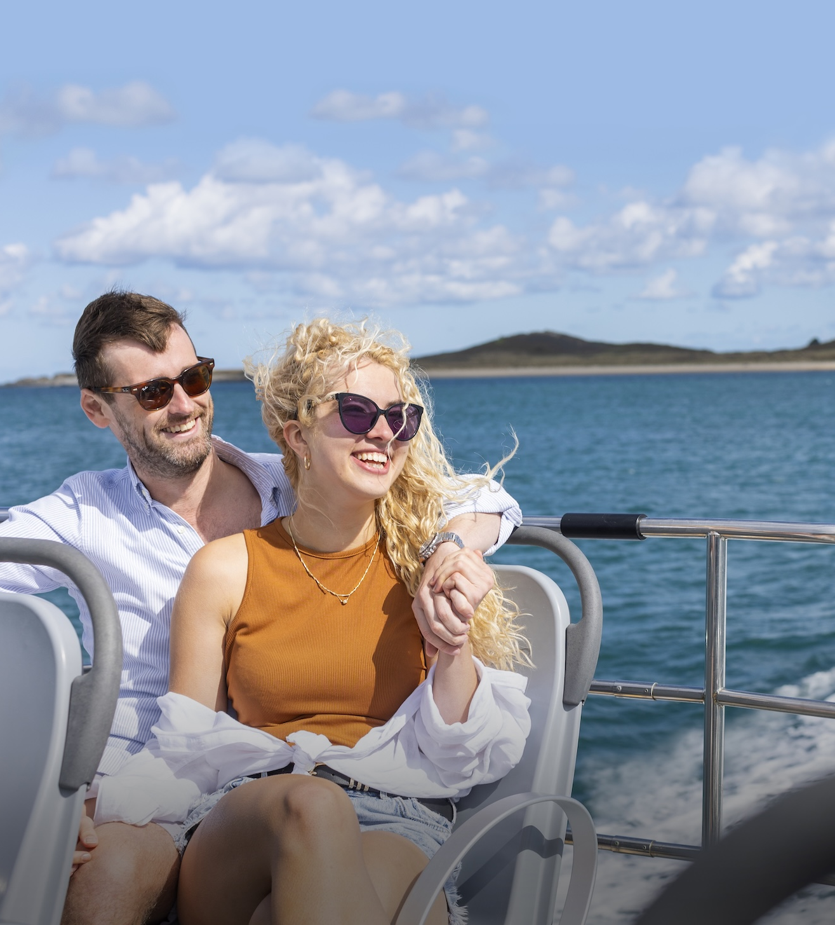
Ambassador Scheme
Making a
Conversation
Verbal vs non-verbal communications
Open or closed questions
Finding out customer interests
Break out exercise – Topics to Avoid
Notes:
Verbal vs non-verbal communication – 80%+ of communication is non-verbal.
Open questions – who, where, what when, why.
Closed questions – leads to a yes/no answer
Which should you use when finding out visitors’ interests
Break out exercise – Topics to Avoid – 15 minutes.
The group should give you politics, local politics, religion, illness, divorce etc

Slide 8
First Impressions
Businesses that Wow

Slide 9
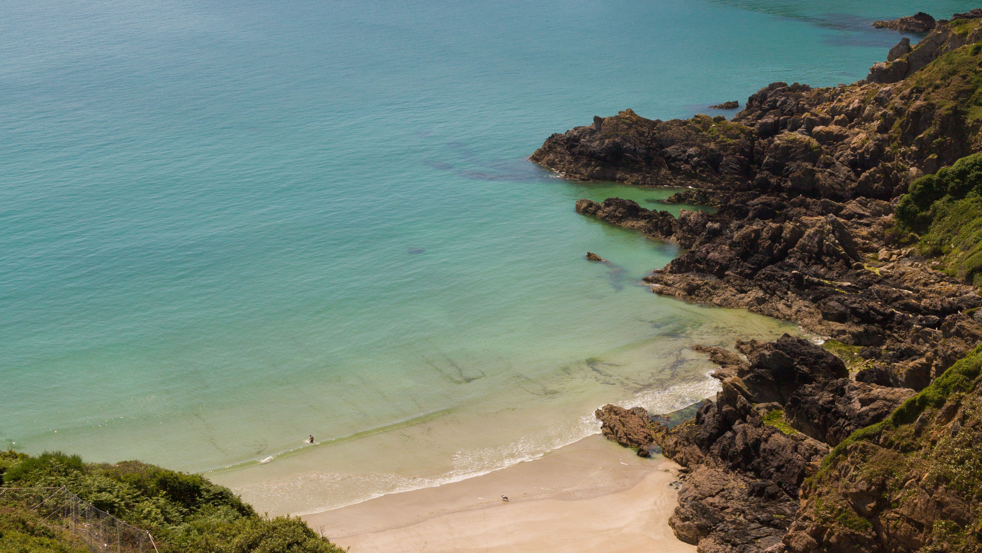
Great service is
about great people
'I've learned that people will forget what you said, people will forget what you did, but people will never forget how you made them feel’
Maya Angelou
Notes:
Great customer care is delivered by lovely people that really care.

Slide 10
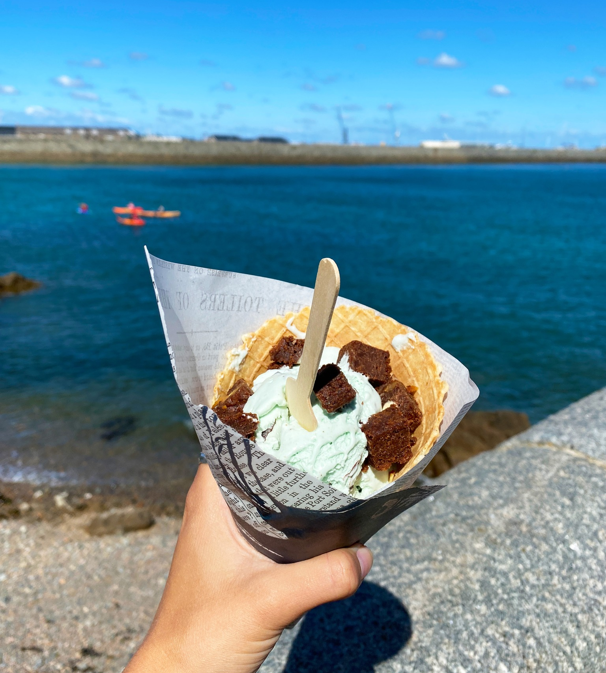
Ambassador Scheme
Exercise:
Good vs Bad Experiences
Who in Guernsey does customer care well,
who does it badly?
What makes a good experience?
What makes a bad experience?
Notes:
Breakout exercise – 15 mins
What local business does customer care well ?
What makes a bad experience ?
Suggest: clothes shop / restaurant / sandwich bar / doctor / bank / supermarket
Following feedback from the breakout exercise
What kind of experience do participants/companies/industry sector offer ?

Slide 12
Ambassador Scheme
Recognise and reward
How do you recognise and reward great behaviours?
Rewards
Acknowledgement
Formal feedback e.g. appraisals
Team discussion
Online reviews e.g. trip advisor
Recognise each other’s great behaviours
Notes:
If you want to encourage great behaviours, how do you recognize and reward those that do.
Somethings to consider in your workplaces
Should be updated to reflect your place of work/industry sector

Slide 13
Ambassador Scheme
How to deal with a complaint
Online – answer negative comments / reply and move the conversation privately
Social media
TripAdvisor etc.
In person
Remain calm
Demonstrate you have listened – repeat back to them
Show empathy
Escalate to your manager / someone who can help
Notes:
Update to reflect your company’s own policies where necessary
You may only want to detail where staff might want to escalate the complaint.

Slide 14
The Value of Tourism

Slide 15

Ambassador Scheme
Breakout:
What attracts tourists to the Islands?
Notes:
Breakout exercise – 25 mins
What local business does customer care well ?
What makes a bad experience ?
Suggest: clothes shop / restaurant / sandwich bar / doctor / bank / supermarket
Following feedback from the breakout exercise
What kind of experience do participants/companies/industry sector offer ?

Slide 16


Ambassador Scheme
Great service is
about great people
The Value of
Tourism
'I've learned that people will forget what you said, people will forget what you did, but people will never forget how you made them feel'
Maya Angelou
Value to Guernsey
Visitor markets
Reasons for travelling
Out and about in the community
Where to find further information

Slide 17

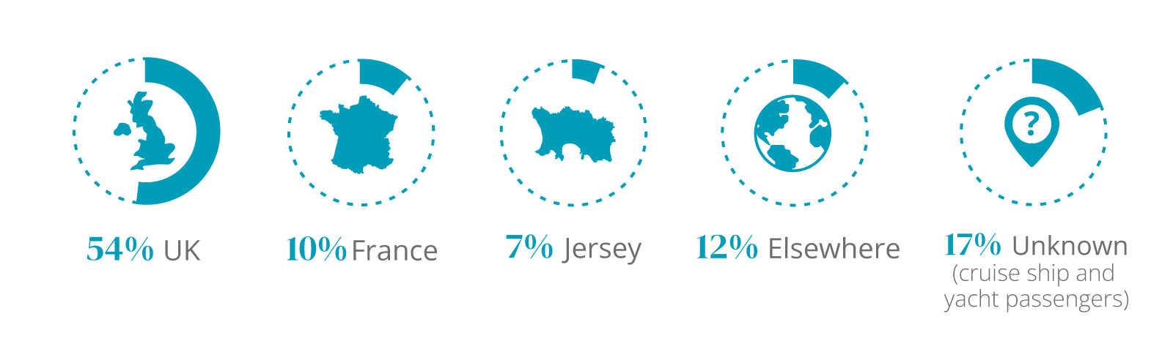
Ambassador Scheme
Visitor Markets
Notes:
Amend to cover information that your guests would regularly ask
Share links with attendees so they are familiar with the resources available.

Slide 18
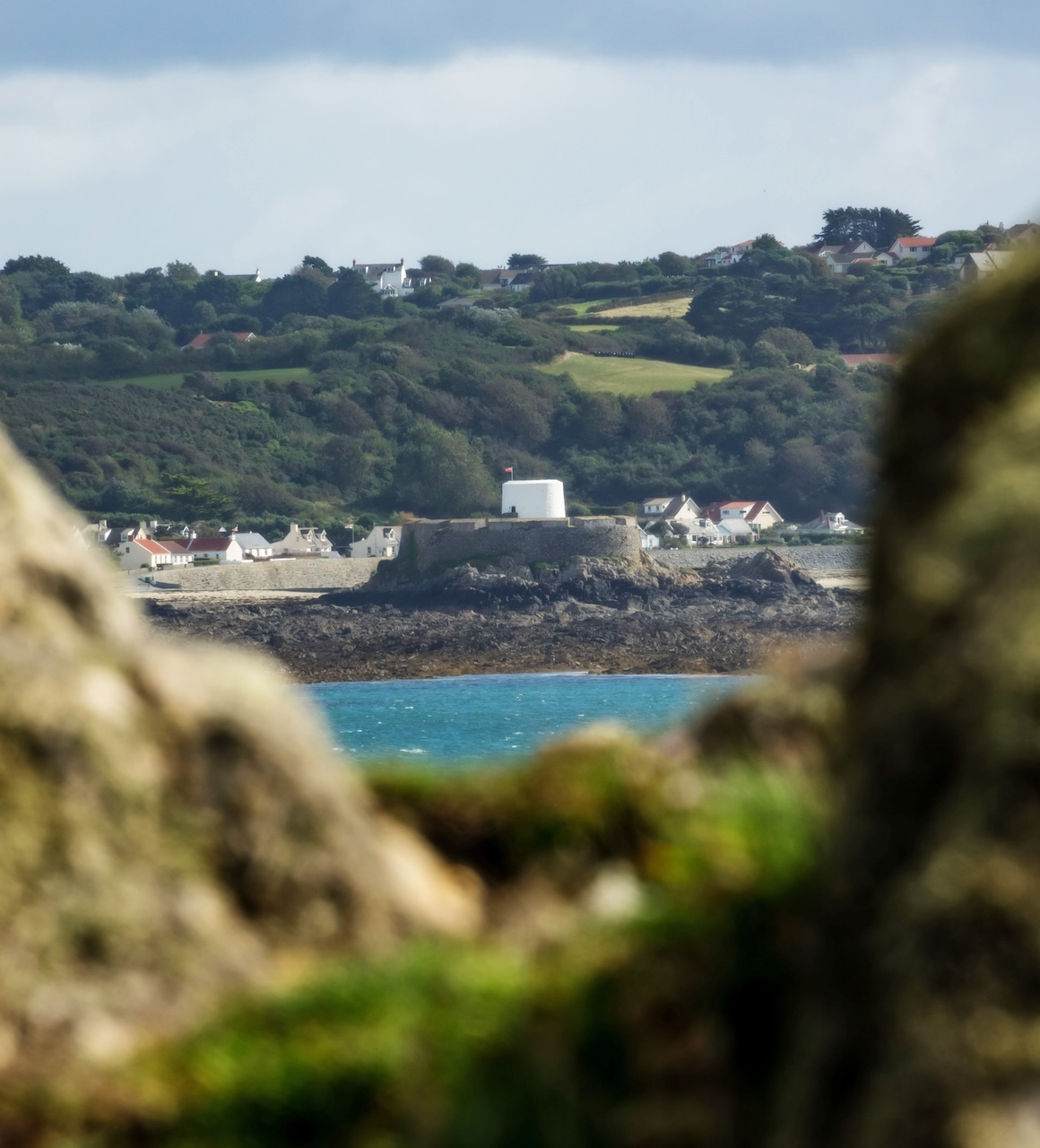
Ambassador Scheme
What attracts tourists?
Notes:
Amend to cover information that your guests would regularly ask
Share links with attendees so they are familiar with the resources available.

Slide 19
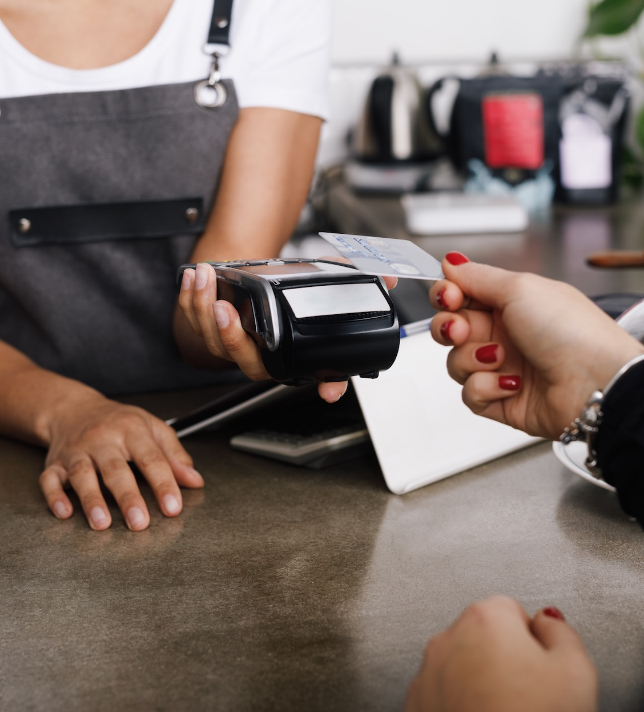

Ambassador Scheme
The economic benefit
Supporting connectivity which benefits local residents and other businesses
Amazing restaurants, which also benefits local residents
Supporting arts, sports and other events, contributing to our vibrant island life
Notes:
Amend to cover information that your guests would regularly ask
Share links with attendees so they are familiar with the resources available.

Slide 20
Ambassador Scheme
Discussion:
How to sell each other
Know what’s on, and recommend events and activities
VG website - https://www.visitguernsey.com/
Guernsey arts - https://arts.gg/whats-on/
Guernsey info Centre – 01481 223552
Notes:
Break out session
What is on this week/this month ?
What would you recommend to visitors ?

Slide 21
Ambassador Scheme
Knowledge
Specific to you and your business
Upskill and research
Be aware of what events and activities are happening soon
Be proud and part of your community, for example
  A friendly taxi driver pointing out a few places to visit on the way to their accommodation
  An enthusiastic guide talking about how much they love the islands and enjoy their job
  A helpful waiter explaining the local delicacies and suggesting fresh produce
Notes:
Please adapt slide to be relevant to you / your industry / business / group.

Slide 22
Ambassador Scheme
What are our main attractions?
Examples include:
Island hopping experience– we are five Islands
Castle Cornet
The Little Chapel
Hauteville House
Guernsey Museums (incl Fort Grey / German Naval Signals HQ) and Art Gallery at Candie
Other museums, incl German Occupation Museum / German Underground Hospital / La Vallette
Sausmarez Manor
Wild swimming and outdoor saunas
Incredible beaches
Thriving foodie scene – Vraic, Fukku, Alba – putting Guernsey on the foodie map
Oatlands Village
Know the seasonal and opening hours

Slide 23
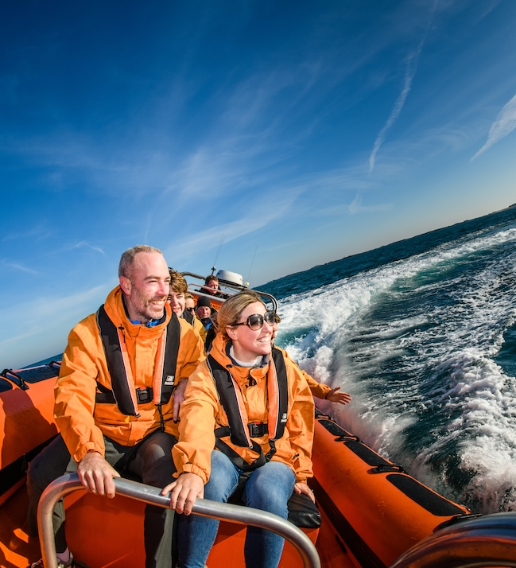
Ambassador Scheme
Popular
excursions
Island Hopping
Day trips to Herm, Sark, Lihou, Alderney and Jersey
Outdoor experiences
Cycling, Kayaking, Paddleboarding, Surfing etc
Guided Tours led by local guides
by coach, taxi, walking and cycling
Tasting experiences
Rocquettes Cider, Little Big Group, Seaweed tour

Slide 24

Ambassador Scheme
The Big Eat
New food festival taking place in April and October
40+ events and menus celebrating local produce
Boost tourism during the shoulder seasons
Position Guernsey as a leading foodie destination
A series of immersive experiences
Dedicated VisitGuernsey marketing campaign
Wide exposure via press, social media, trade mailers and a new festival website

Slide 25
Disability Awareness

Slide 26
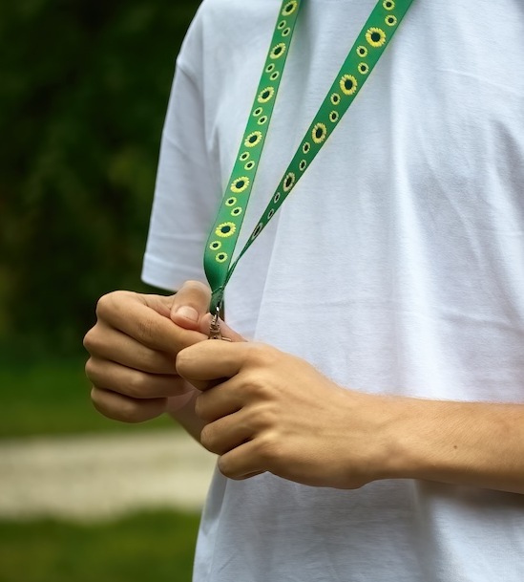
Ambassador Scheme
Great service is
about great people
Great service is
about great people
Disability
Awareness
'I've learned that people will forget what you said, people will forget what you did, but people will never forget how you made them feel'
Maya Angelou
'I've learned that people will forget what you said, people will forget what you did, but people will never forget how you made them feel'
Maya Angelou
When and how to offer help
Hidden disabilities
Complying with the Law.
Making reasonable adjustments
New slides
Notes:
Make revelant for your own business/sector

Slide 27
More information

Slide 28
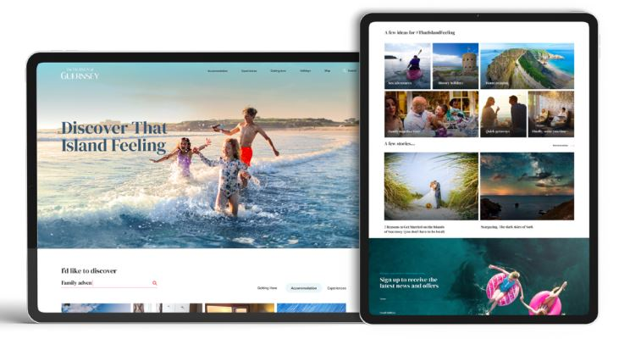
Ambassador Scheme
Find it online
Notes:
Website
App

Slide 29
Ambassador Scheme
Taxi References
Driver Vehicle Licensing Department
01481 221000
Guernsey Taxi Drivers Association GTDA
President Peter Blondel
Email committee@gtda.org.gg
Web https://www.gtda.org.gg/
Guernsey Taxi App.
29
Notes:
Please amend to be specific to your organization and sector

Slide 30
Ambassador Scheme
Other useful information
https://www.visitguernsey.com/planning/useful-information/
Where the visitor info centre is
How to get a doctor
Emergency numbers
Cash exchange
Disability awareness
Accessibility + Ron Short Centre / transport
30
Notes:
Please amend to be specific to your organization and sector

Slide 31
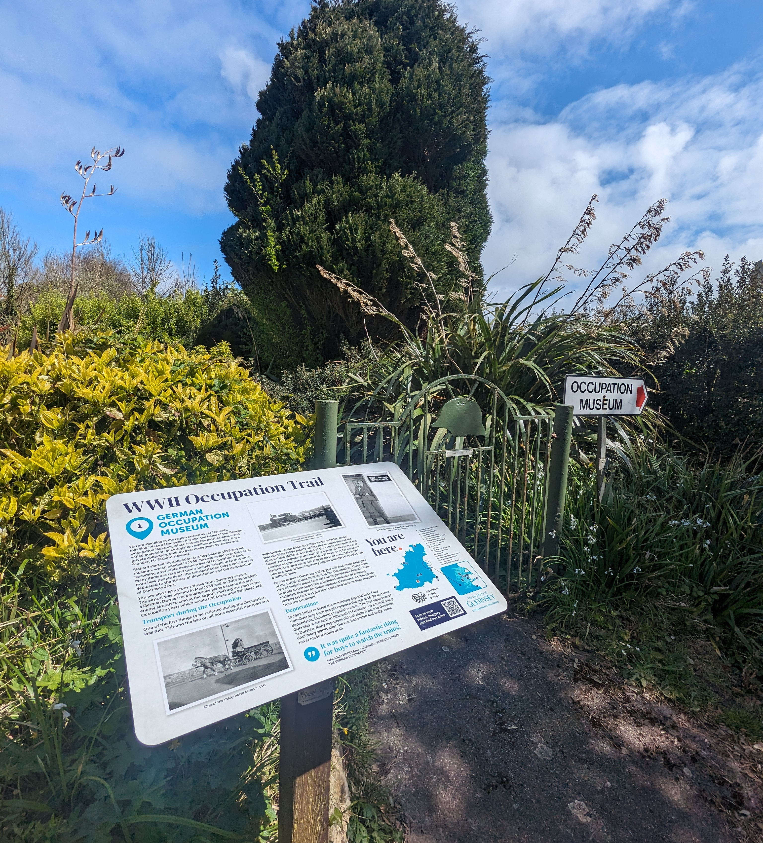
Resources
Ambassador Scheme
Consumer website
www.visitguernsey.com
Trades website
www.trade.visitguernsey.com
Trade newsletter
Guernsey Info Centre
VG app
Social Media
@VisitGuernsey
#ThatIslandFeeling
Give feedback at trade.visitguernsey.com under The Ambassador Scheme page
Notes:
Sign up to the monthly trade mailer to hear the latest news and updates

Slide 32
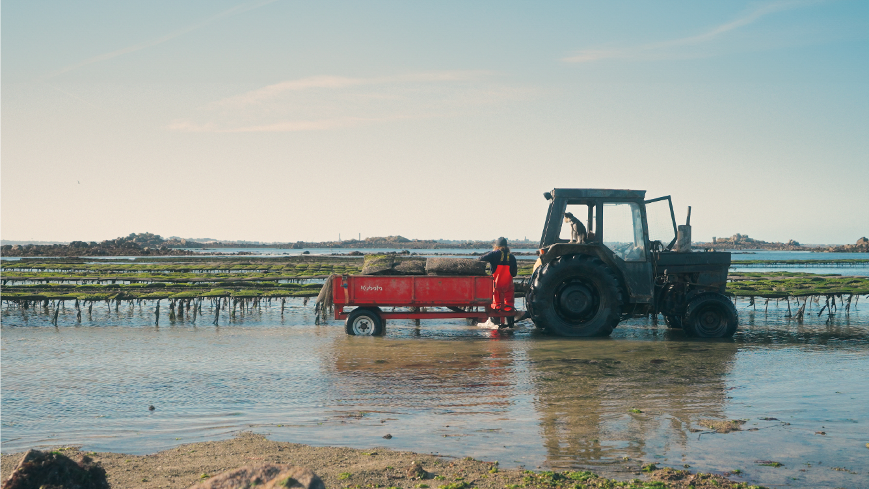
Thank you

